Slide 1
Minicase 13
Group 13
YE Chen 2430026255

Slide 2
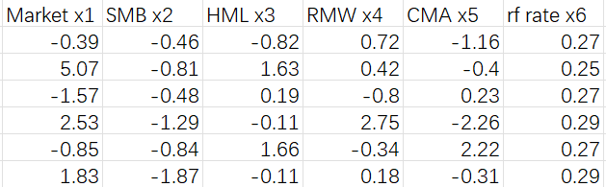
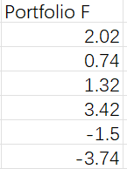
Data Overview
X1 – Market
captures overall market return
X5 – CMA
conservative vs aggressive investment
X2-SMB
return of small vs big firms
Y-Portfolio F
monthly return of portfolio
Predict
X3 – HML
value vs growth return
X6 – rf rate
risk-free benchmark rate
X4 – RMW
profitability premium factor
There are 492 observations in total, and we use the seven variables shown above to conduct the correlation analysis.

Slide 3
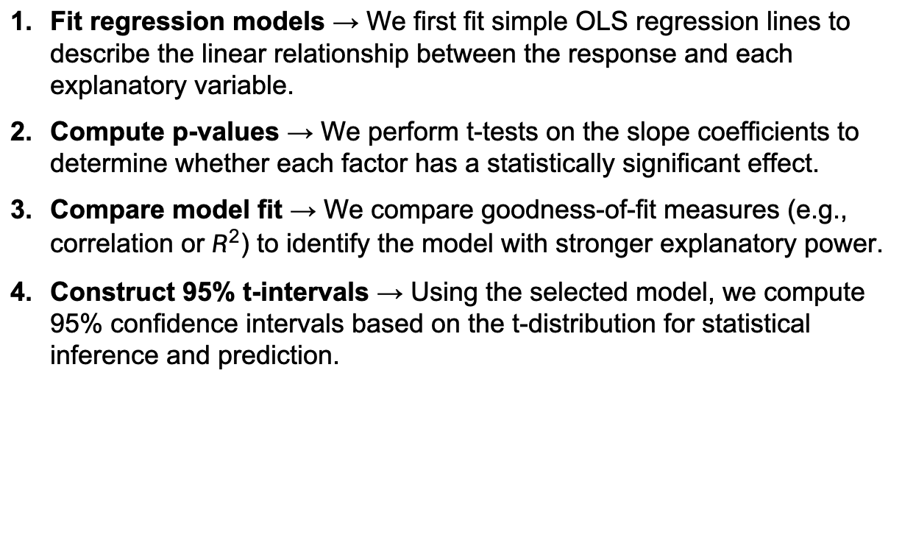
Analysis Method
Fit regression models → We first fit simple OLS regression lines to describe the linear relationship between the response and each explanatory variable.
Compute p-values → We perform t-tests on the slope coefficients to determine whether each factor has a statistically significant effect.
Compare model fit → We compare goodness-of-fit measures (e.g., correlation or $R^{2}$) to identify the model with stronger explanatory power.
Construct 95% t-intervals → Using the selected model, we compute 95% confidence intervals based on the t-distribution for statistical inference and prediction.

Slide 4
Problem 1
Comparison of Simple Regression models:
x1(Market) VS. x2(SMB)
2430026255
Ye Chen

Slide 5




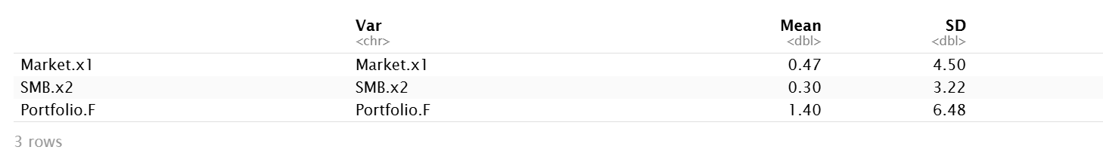
Problem 1 Question Background
X1 – Market
X2 – SMB
Y – Protfolio.F
captures overall market return
return of small vs big firms
value vs growth return
Market.x1 and SMB.x2 show relatively small average returns with moderate volatility, while Portfolio.F exhibits a higher mean but also substantially larger standard deviation.

Slide 6
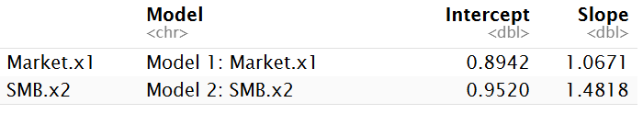
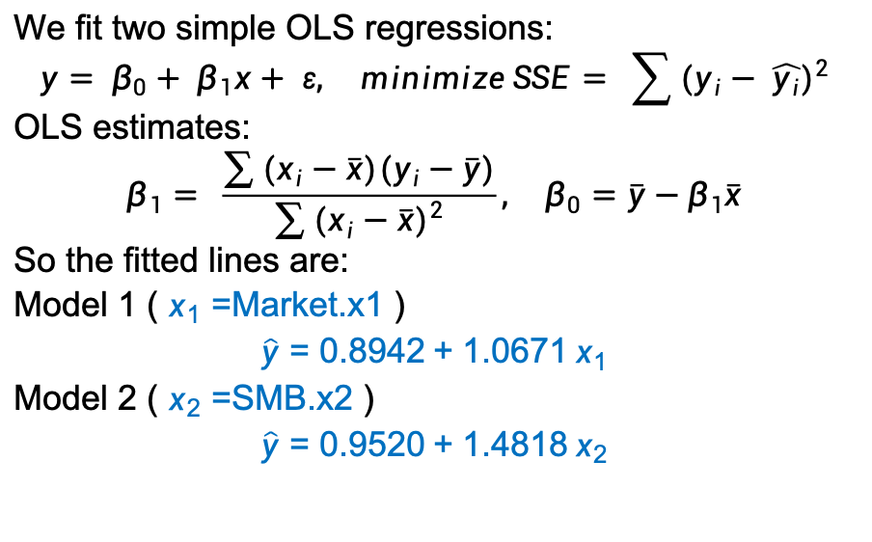
Problem1(a)-Fitted Regression Models
Method
We fit two simple OLS regressions:
$$y= β_{0}+ β_{1}x+ ε, minimize SSE= \sum{{(y_{i}− \hat{y_{i}})}^{2}}$$
OLS estimates:
$$β_{1}= \frac{\sum{(x_{i}−\overline{x})(y_{i}−\overline{y})}}{\sum{{(x_{i}−\overline{x})}^{2}}},{ β}_{0}=\overline{y}−β_{1}\overline{x}$$
So the fitted lines are:
Model 1 ( $x_{1}=$Market.x1 )
$$\hat{y}=0.8942+1.0671 x_{1}$$
Model 2 ( $x_{2}=$SMB.x2 )
$$\hat{y}=0.9520+1.4818 x_{2}$$
R Output:
Conclusion
The simple linear regressions yield positive fitted relationships between Portfolio.F and both Market.x1 and SMB.x2, providing estimated regression lines that summarize how Portfolio.F changes on average with each factor.

Slide 7
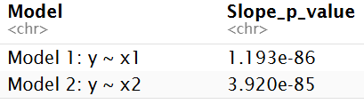
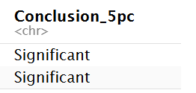
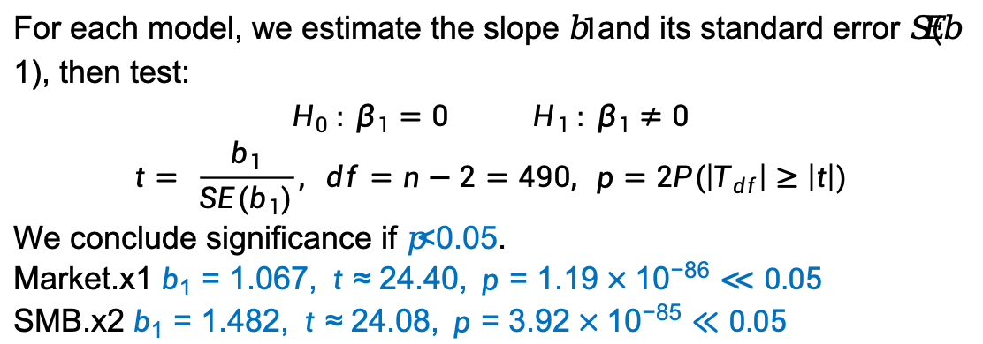
Problem1(b) - Slope Significance Test
Method
For each model, we estimate the slope 𝑏$1$and its standard error 𝑆𝐸(𝑏1), then test:
$$H_{0} : β_{1}=0 H_{1} : β_{1}≠0$$
$$t= \frac{b_{1}}{SE(b_{1})}, df=n−2=490, p=2P(\left|T_{df}\right|≥\left|t\right|)$$
We conclude significance if 𝑝<0.05.
Market.x1 $b_{1}=1.067, t≈24.40, p=1.19×{10}^{−86}≪0.05$
SMB.x2 $b_{1}=1.482, t≈24.08, p=3.92×{10}^{−85}≪0.05$
R Output:
Both slopes are significant at the 5% level, so $H_{0}$ is rejected for both models. It support that this is significant positive linear relationship.

Slide 8
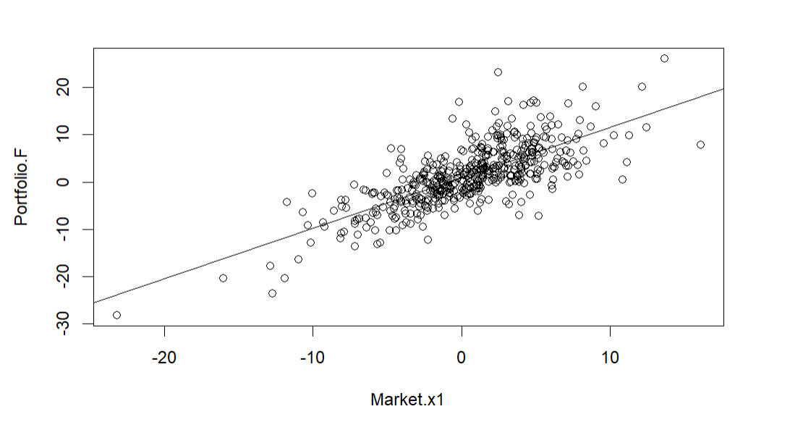
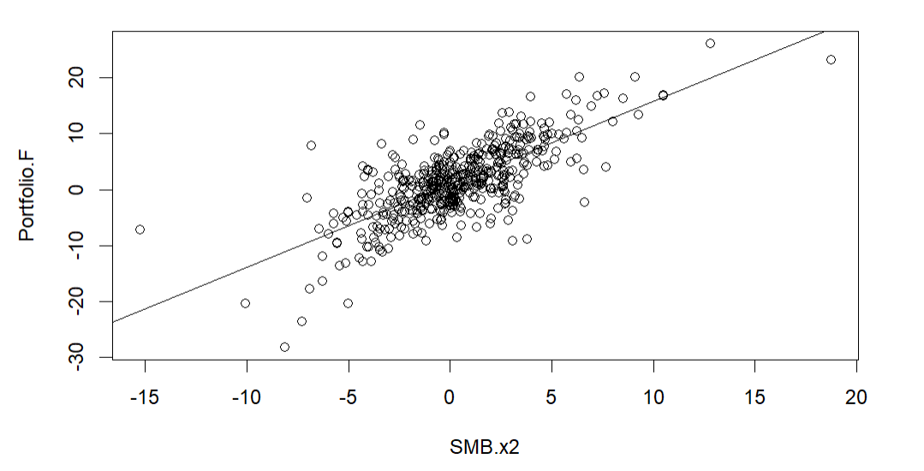
Problem1(b) - Slope Significance Test
Both scatterplots show clear positive linear trends, indicating that higher Market.x1 and SMB.x2 values are associated with higher Portfolio.F returns.
Conclusion
The upward trends indicate that higher factor values are associated with higher Portfolio.F returns. And both slopes are significant at the 5% level, all of this support that this is significant positive linear relationship.

Slide 9






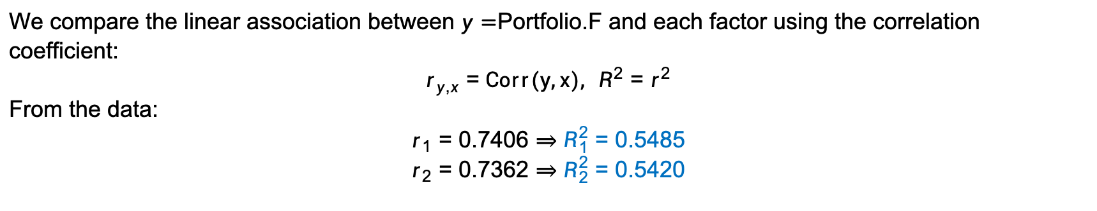
Problem1(c)-Model Comparison & 95% Prediction
Method
We compare the linear association between $y=$Portfolio.F and each factor using the correlation coefficient:
$$r_{y,x}=Corr(y,x), R^{2}=r^{2}$$
From the data:
$$r_{1}=0.7406⇒R_{1}^{2}=0.5485$$
$$r_{2}=0.7362⇒R_{2}^{2}=0.5420$$
R Output:
$$r_{1}$$
$$>$$
$$r_{2}$$
$$R_{1}^{2}$$
$$>$$
$$R_{2}^{2}$$
Thus Model 1 has slightly better fit and is selected as the better model.

Slide 10

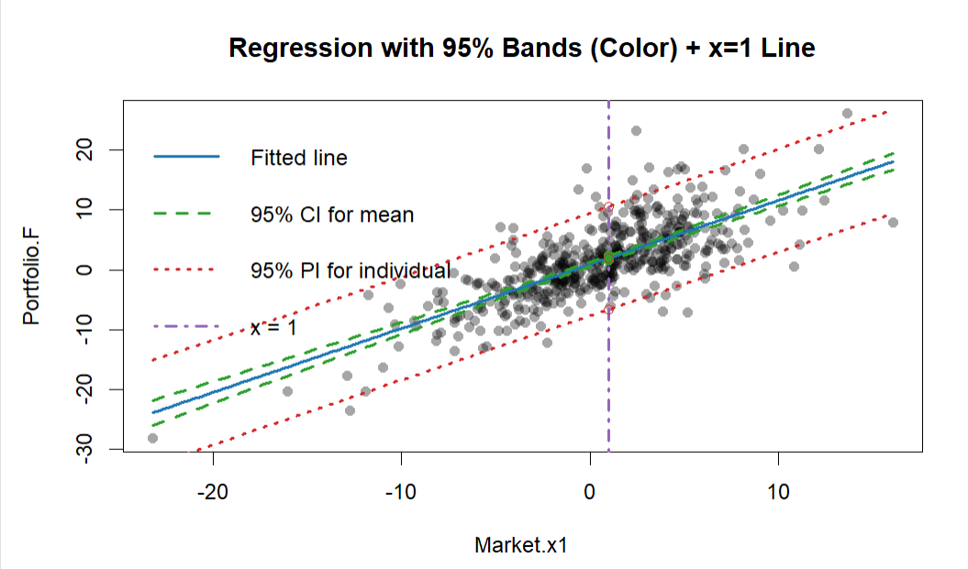


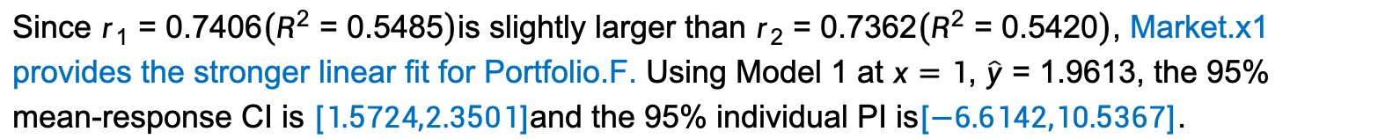
Problem1(c)-Model Comparison & 95% Prediction
Method
R Output:
Using the chosen model, compute intervals at $x_{0}=1$: we compute interval estimates at $x_{0}=1$. The estimated standard error of the mean response is
$$\text{Mean}\text{−}\text{response} \text{95}\text{\% }\text{CI}\text{: }\hat{y}\left(x_{0}\right)±t_{0.975, n−2} SE_{mean}\left(x_{0}\right).$$
For predicting a future individual observation, the uncertainty includes additional random variation, leading to
$$\text{Individual} \text{95}\text{\% }\text{PI}\text{: }\hat{y}\left(x_{0}\right)±t_{0.975, n−2} SE_{pred}\left(x_{0}\right).$$
Conclusion of Problem1
Both Market.x1 and SMB.x2 show positive linear relationships with Portfolio.F, indicating that Portfolio.F tends to increase as the factors increase.Market.x1 exhibits a slightly stronger association and is therefore preferred for prediction.
This has important statistical significance: The fitted regression line provides a clear directional (positive) effect for forecasting. The mean-response CI measures uncertainty in expected returns, while the individual PI captures the variability of future realized values.
CI ： $\left[1.5724,2.3501\right]$
PI ： $[−6.6142,10.5367]$
The scatterplot shows a clear positive linear trend between Market.x1 and Portfolio.F, with the prediction band wider than the mean-response confidence band.
Conclusion
Since $r_{1}=0.7406\left(R^{2}=0.5485\right)$is slightly larger than $r_{2}=0.7362\left(R^{2}=0.5420\right)$, Market.x1 provides the stronger linear fit for Portfolio.F. Using Model 1 at $x=1$, $\hat{y}=1.9613$, the 95% mean-response CI is $[1.5724,2.3501]$and the 95% individual PI is$[−6.6142,10.5367]$.

Slide 11
Problem2
Comparison of Simple Regression models:
x1(Market) VS. x2(HML)
2430026126
Liu Fangbing

Slide 12
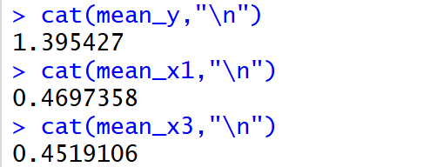
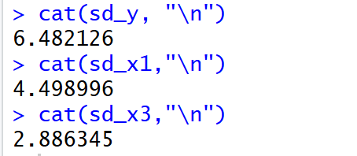
Problem 2 Question Background
Var | Mean | SD
y | 1.40 | 6.48
x1 | 0.47 | 4.50
x3 | 0.45 | 2.89
Using 492 monthly observations, we examine Portfolio.F (y) versus Market.x1 (x1) and HML.x3 (x3). Returns are volatile (x1: mean 0.47, SD 4.50; x3: mean 0.45, SD 2.89; y: mean 1.40, SD 6.48).
The purpose of this analysis is to assess whether Portfolio.F has a meaningful linear relationship with Market.x1 and HML.x3 using simple regression lines, identify the factor with stronger linear association, and report uncertainty ranges for the mean and individual responses at specified x values.

Slide 13
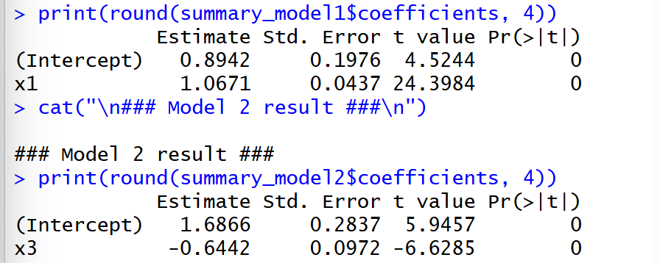
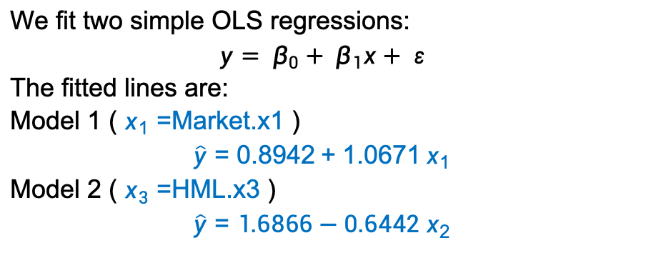
Problem2(a)-Fitted Regression Models
Method
We fit two simple OLS regressions:
$$y= β_{0}+ β_{1}x+ ε$$
The fitted lines are:
Model 1 ( $x_{1}=$Market.x1 )
$$\hat{y}=0.8942+1.0671 x_{1}$$
Model 2 ( $x_{3}=$HML.x3 )
$$\hat{y}=1.6866−0.6442 x_{2}$$
R Output:
Conclusion
The simple linear regressions reveal positive fitted relationships between Portfolio F and Market.x1, while demonstrating a negative association with HML.x3. The estimated regression lines quantify how Portfolio F systematically varies with fluctuations in these factors

Slide 14
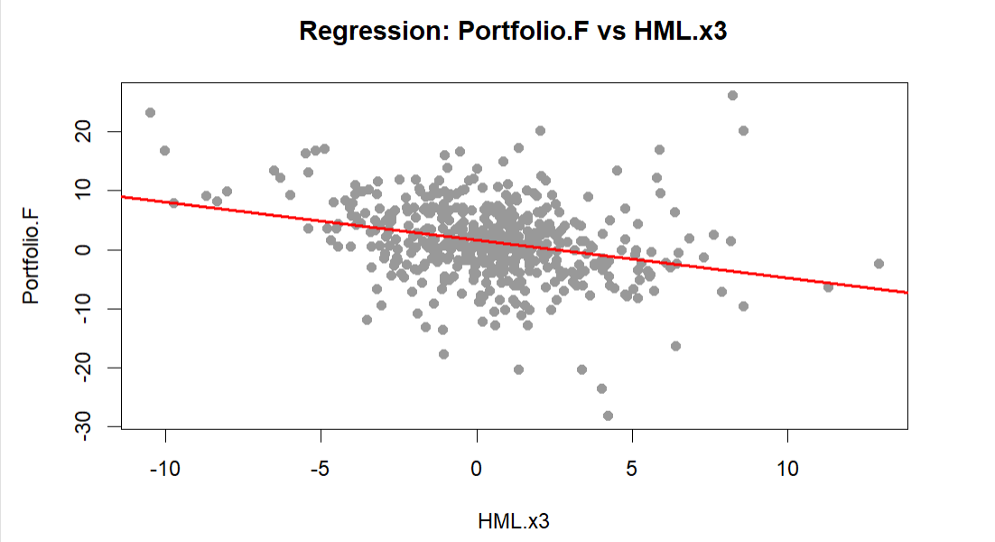
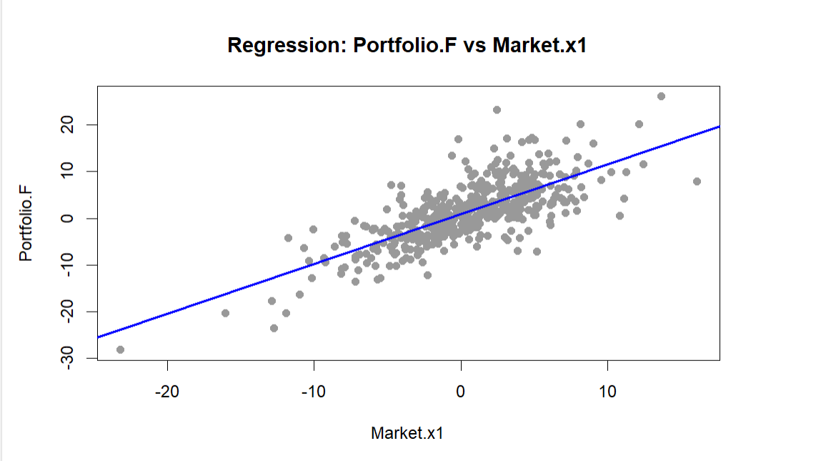
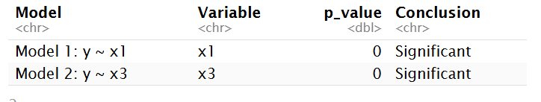
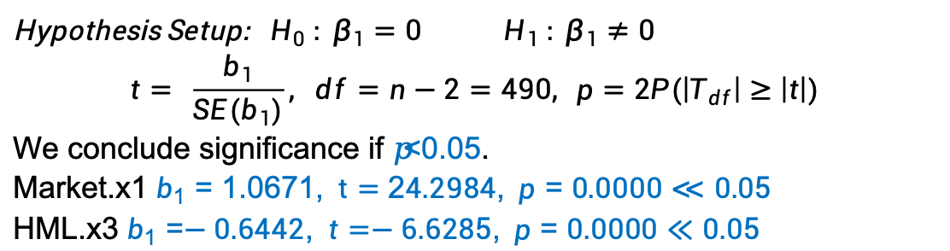
Problem2(b) - Slope Significance Test
Method
Hypothesis Setup: $H_{0} : β_{1}=0 H_{1} : β_{1}≠0$
$$t= \frac{b_{1}}{SE(b_{1})}, df=n−2=490, p=2P(\left|T_{df}\right|≥\left|t\right|)$$
We conclude significance if 𝑝<0.05.
Market.x1 $b_{1}=1.0671, t=24.2984, p=0.0000≪0.05$
HML.x3 $b_{1}=−0.6442, t=−6.6285, p=0.0000≪0.05$
R Output:
The plots show a significant positive linear relationship between Portfolio.F and Market.x1, and a significant negative relationship with HML.x3.
Conclusion
Both hypothesis tests and regression plots confirm the same result: $x_{1}$and $x_{3}$have significant linear effects on Portfolio.F, with a positive trend for $x_{1}$and a negative trend for $x_{3}$.

Slide 15
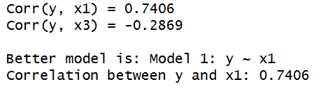
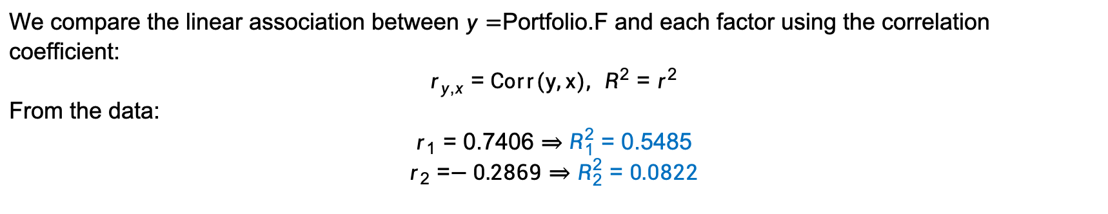
Problem2(c)-Model Comparison & 95% Prediction
Method
We compare the linear association between $y=$Portfolio.F and each factor using the correlation coefficient:
$$r_{y,x}=Corr(y,x), R^{2}=r^{2}$$
From the data:
$$r_{1}=0.7406⇒R_{1}^{2}=0.5485$$
$$r_{2}=−0.2869⇒R_{2}^{2}=0.0822$$
R Output:
${R_{1}}^{2}>{R_{2}}^{2},$thus Model 1 has slightly better fit and is selected as the better model.

Slide 16


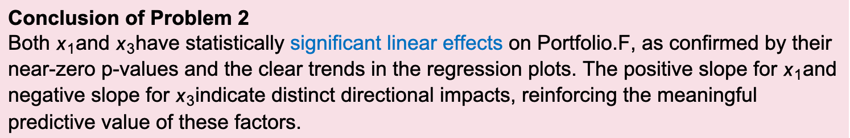
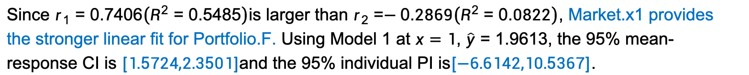
Problem2(c)-Model Comparison & 95% Prediction
Method
Because we use the same model as in Question 1 to compute the 95% prediction interval, the procedure and results are identical, so no further explanation is provided here.
R Output:
Conclusion
Since $r_{1}=0.7406\left(R^{2}=0.5485\right)$is larger than $r_{2}=−0.2869\left(R^{2}=0.0822\right)$, Market.x1 provides the stronger linear fit for Portfolio.F. Using Model 1 at $x=1$, $\hat{y}=1.9613$, the 95% mean-response CI is $[1.5724,2.3501]$and the 95% individual PI is$[−6.6142,10.5367]$.
Conclusion of Problem 2
Both $x_{1}$and $x_{3}$have statistically significant linear effects on Portfolio.F, as confirmed by their near-zero p-values and the clear trends in the regression plots. The positive slope for $x_{1}$and negative slope for $x_{3}$indicate distinct directional impacts, reinforcing the meaningful predictive value of these factors.

Slide 17
Problem 3
Market Factor (x1) vs RMW Factor (x4)
WangZhengyang 2330031281

Slide 18

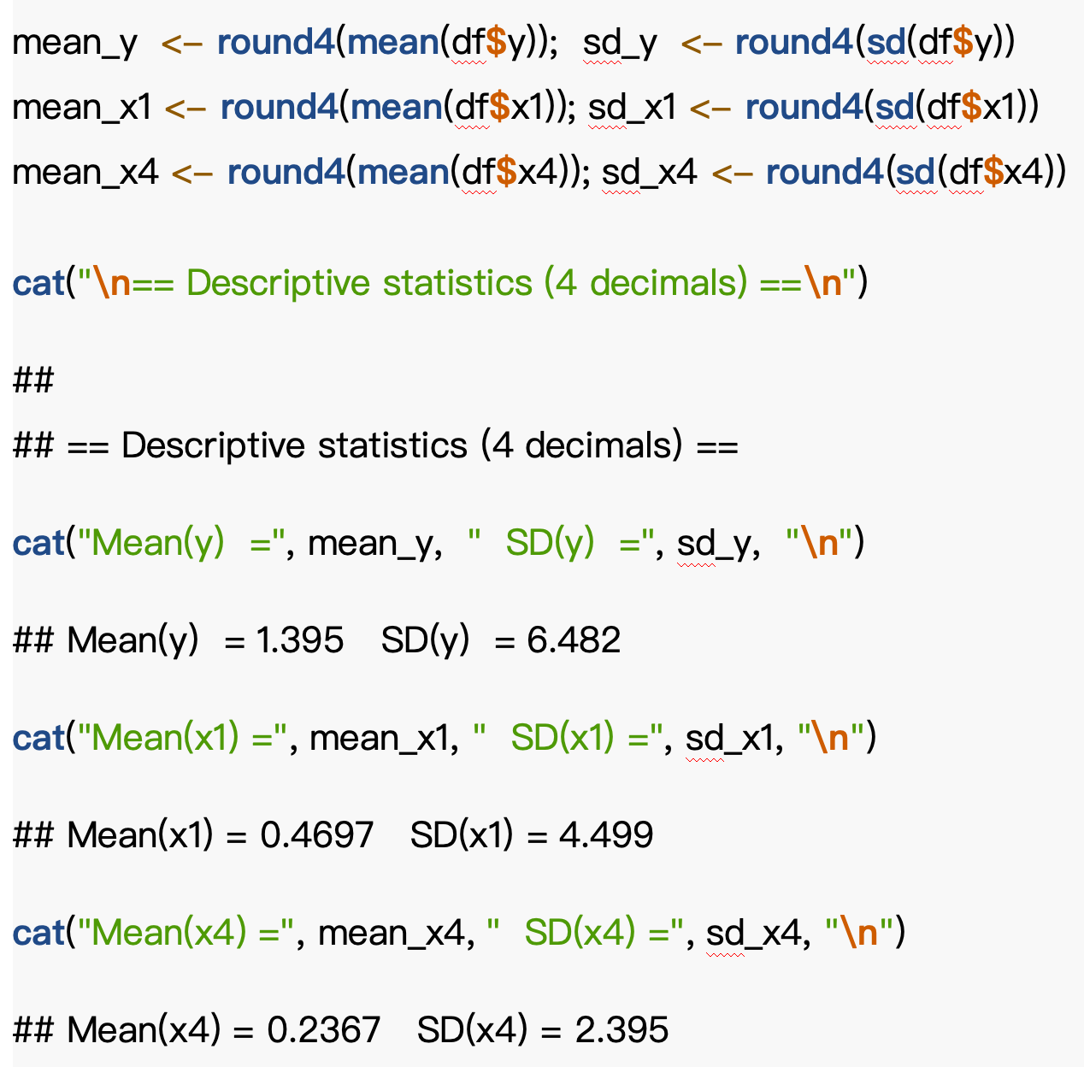


Problem 3
Question Background
X1 – Market
captures overall market return
Y（Portfolio F）
monthly return of portfolio
X4 – RMW
profitability premium factor
Market.x1 and SMB.x4 show relatively small average returns with moderate volatility, while Portfolio.F exhibits a higher mean but also substantially larger standard deviation.
Notes:
“Here, y is the monthly return of Portfolio F, and we focus on Market x1 and RMW x4.
From the summary stats, Portfolio F has a positive mean but a much larger standard deviation, which tells us the returns are quite volatile.”

Slide 19
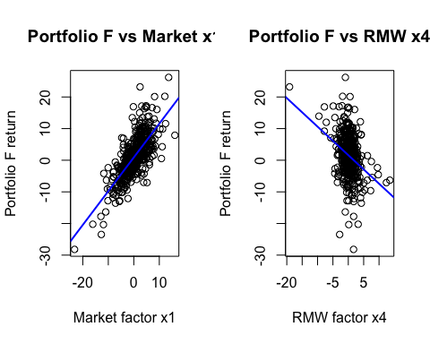
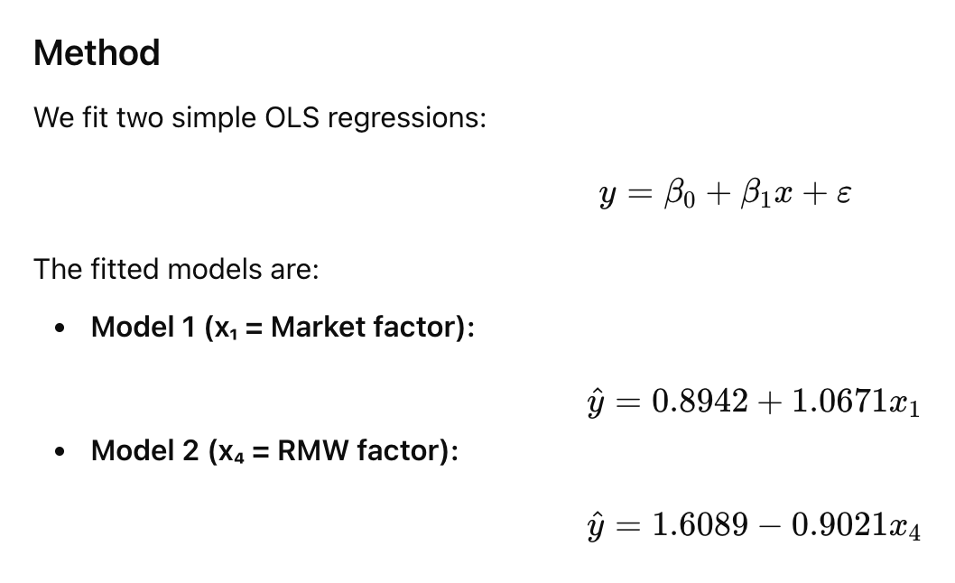
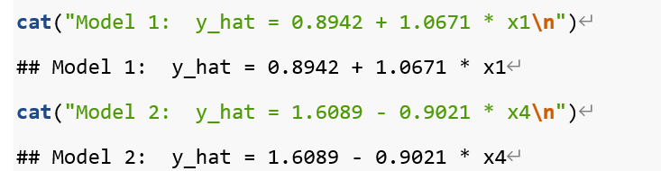
Problem3(a)-
Fitted Regression Models
R Output:
Both scatterplots show clear linear patterns:
a strong positive relationship with Market x1, and a weaker negative relationship with RMW x4.
Conclusion
Model 1 shows a stronger and clearer linear trend than Model 2.
Notes:
“We fit two simple linear regressions, one with x1 and one with x4.
The fitted results show a positive slope for x1 and a negative slope for x4, and visually the x1 relationship looks much stronger.”

Slide 20

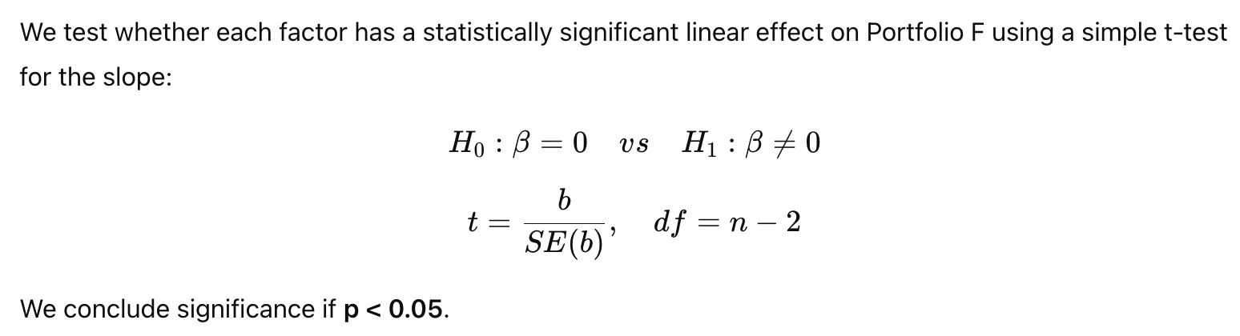

Problem 3(b) - Slope Significance Test
R Output:
Method
Model | Slope (b) | SE(b) | t-value | p-value | Conclusion
y ~ x1 (Market) | 1.0671 | 0.0437 | 24.3984 | 0.0000 | Significant
y ~ x4 (RMW) | −0.9021 | 0.1153 | −7.8245 | 0.0000 | Significant
Notes:
“Next, we test whether the slopes are significantly different from zero.
Both slopes are highly significant, with very large t-values, so both factors have statistically meaningful effects.”

Slide 21
Problem 3(b) - Slope Significance Test
Conclusion
Both slopes are highly significant at the 5% level:
Market x1 has a strong positive effect on Portfolio F.
RMW x4 has a significant negative effect.
Thus, both factors are statistically meaningful, but x1 shows a much stronger effect (larger |t|).
Model | Slope (b) | SE(b) | t-value | p-value | Conclusion
y ~ x1 (Market) | 1.0671 | 0.0437 | 24.3984 | 0.0000 | Significant
y ~ x4 (RMW) | −0.9021 | 0.1153 | −7.8245 | 0.0000 | Significant
Notes:
“In terms of direction, Market x1 has a strong positive effect, while RMW x4 has a significant negative effect.
Since the t-value for x1 is much larger, x1 clearly has the stronger impact.”

Slide 22
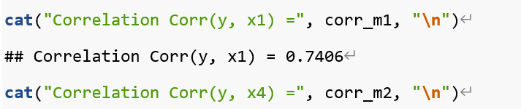
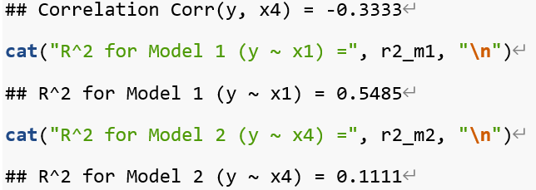

Problem 3(c)-Model Comparison & 95% Prediction
R Output:
Method
We compare the two models using two criteria:
Correlation coefficient between y and x
R² from each simple regression
The model with stronger linear association will be used to compute:
95% Confidence Interval (CI) for the mean response
95% Prediction Interval (PI) for an individual response at x = 1
Model | Corr(y, x) | R²
y ~ x1 (Market) | 0.7406 | 0.5485
y ~ x4 (RMW) | −0.3333 | 0.1111
Model 1 (Market) has a much stronger association → selected as the better model.
Notes:
“To choose the better model, we compare correlation and R-squared.
Model 1 has a correlation around 0.74 and explains about 55% of the variation, which is much higher than Model 2, so we select Market x1.”

Slide 23
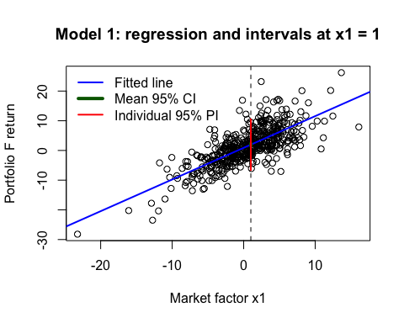
Problem 3(c)-Model Comparison & 95% Prediction
Conclusion
Market factor x1 provides the best explanatory power for Portfolio F.
Expected return at x₁ = 1 is about 1.96.
The 95% CI is narrow (precise estimation for the mean), while the 95% PI is much wider, reflecting variability in future individual returns.
Method
Because we use the same model as in Question 1 to compute the 95% prediction interval, the procedure and results are identical, so no further explanation is provided here.
Conclusion of Problem 3
Both Market.x1 and RMW.x4 exhibit clear linear relationships with Portfolio.F, as shown by the fitted regression lines and scatterplots. Market.x1 has a strong positive effect on Portfolio.F, while RMW.x4 shows a weaker negative effect. Overall, Model 1 demonstrates a stronger and more pronounced linear pattern than Model 2, indicating higher explanatory power for Portfolio.F.
Notes:
Using this model, the predicted return at x₁ = 1 is 1.96,
In conclusion，both x1 and x4 are statistically significant predictors of Portfolio.F, with opposite directions.
However, Market x1 provides stronger explanatory power (R2 = 0.5485 vs 0.1111), so
Model 1 is preferred.

Slide 24
Problem 4
Market Factor (x1) vs CMA Factor (x5)
Li Dazheng

Slide 25

Problem 4
Question Background
In this analysis, we used 492 monthly observations to perform a regression analysis on Portfolio F (y) with Market x1 and CMA x5 as predictors. The main objective of this analysis is to assess whether Market x1 and CMA x5 significantly impact Portfolio F (y) and to compare the performance of the two models. We will conduct regression analysis using Model 1 (y ~ x1) and Model 2 (y ~ x5), and compare the models based on the regression results and prediction intervals.

Slide 26
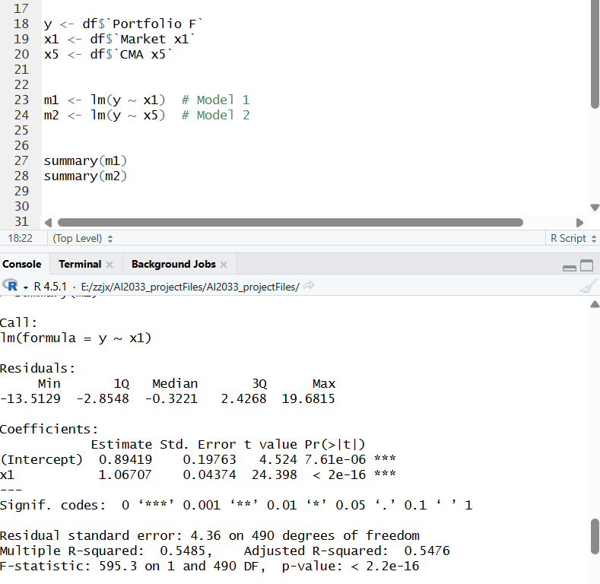
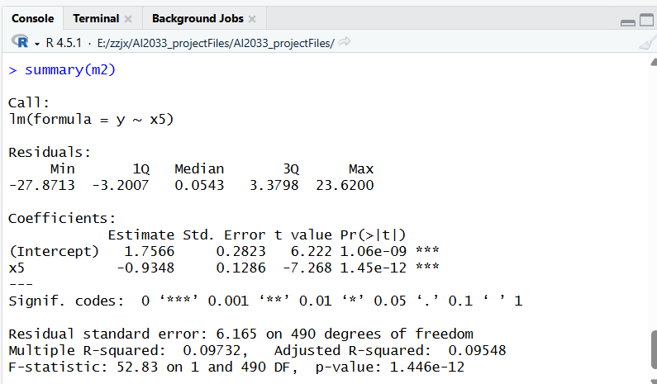
Problem 4 Regression Equation Estimates (a)
Method
We used Ordinary Least Squares (OLS) regression to analyze the relationship
between the predictors (x1, x5)
and the dependent variable (y).
R Output:

Slide 27
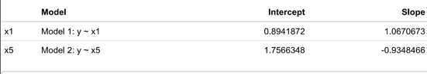
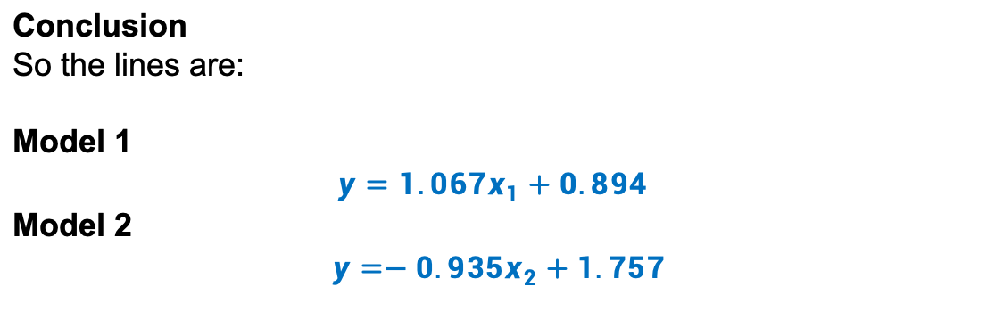
Problem 4(a) R Output
Model 1 output：
Intercept = 0.89419
Slope (x1) = 1.06707
Model 2 output：
Intercept = 1.7566
Slope (x5) = -0.9348
Conclusion
So the lines are:
Model 1
$$y=1.067x_{1}+0.894$$
Model 2
$y=−0.935x_{2}+1.757$

Slide 28
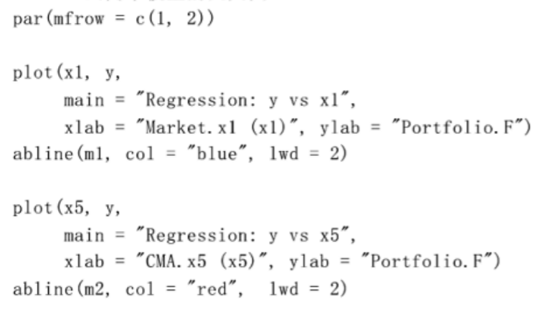
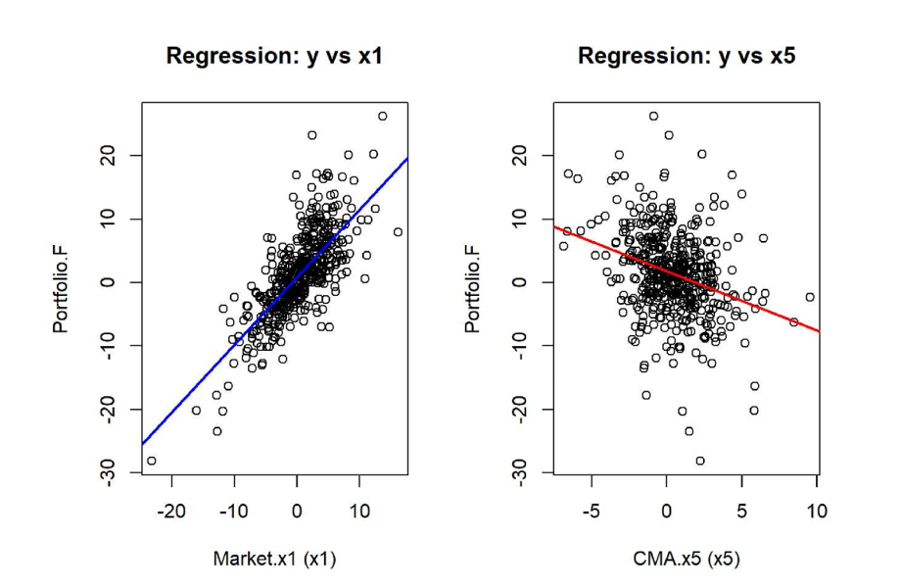
Problem 4 (a) Regression Plot
As CMA.x5 increases, Portfolio F decreases, indicating a negative correlation between x5 and Portfolio F
As Market.x1 increases, Portfolio F also shows an upward trend, suggesting a positive linear correlation between the two variables.
Model 1 (y ~ x1): The regression line is blue, indicating a positive relationship between Market.x1 and Portfolio F. Specifically, the larger the value of x1, the higher the Portfolio F.
Model 2 (y ~ x5): The regression line is red, indicating a negative relationship between CMA.x5 and Portfolio F. Specifically, the larger the value of x5, the lower the Portfolio F.
R Output:

Slide 29

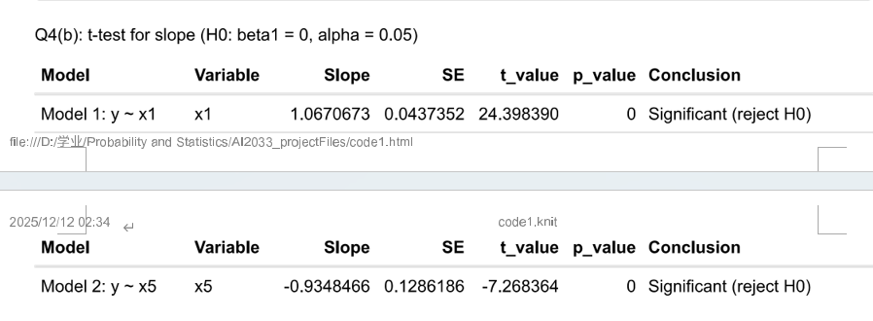
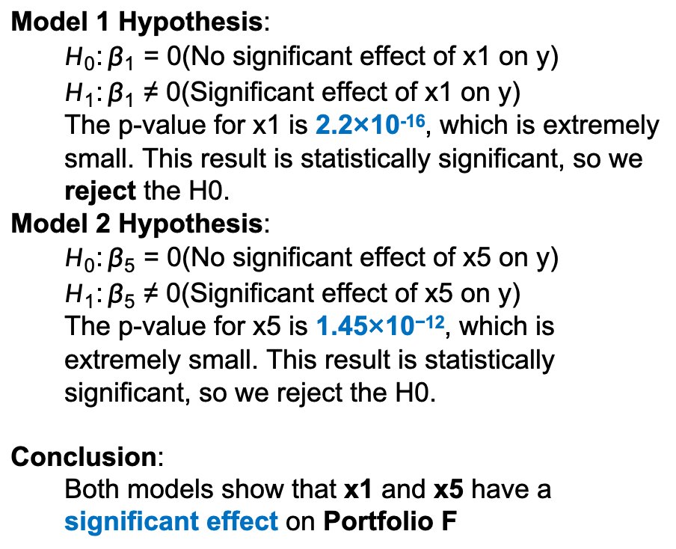
Problem Hypothesis Testing(b)
Model 1 Hypothesis:
  $H_{0}:β_{1}=0$(No significant effect of x1 on y)
  $H_{1}:β_{1}≠0$(Significant effect of x1 on y)
  The p-value for x1 is 2.2×10⁻¹⁶, which is extremely small. This result is statistically significant, so we reject the H0.
Model 2 Hypothesis:
  $H_{0}:β_{5}=0$(No significant effect of x5 on y)
  $H_{1}:β_{5}≠0$(Significant effect of x5 on y)
  The p-value for x5 is 1.45×10⁻¹², which is extremely small. This result is statistically significant, so we reject the H0.
Conclusion:
  Both models show that x1 and x5 have a significant effect on Portfolio F
t-value Test:
Model 1: The t-value of x1 is 24.398, indicating that x1 has a significant impact on y.
Model 2: The t-value of x5 is -7.268, indicating that x5 has a significant impact on y.

Slide 30
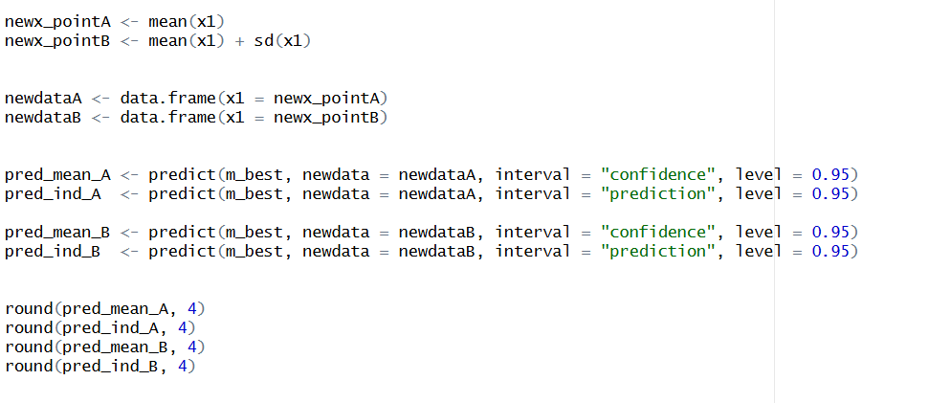
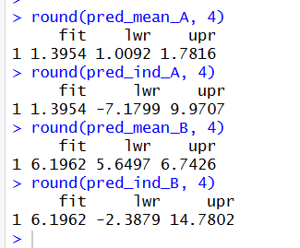
Problem Confidence and Prediction Intervals (c)
Model Selection:
Model 1 has a higher correlation coefficient (0.7406) compared to Model 2 (-0.3119). Therefore, we choose Model 1 as the better model, since it has a stronger linear relationship between the predictor (x1) and the dependent variable (y).
Method
Because we use the same model as in Question 1 to compute the 95% prediction interval, the procedure and results are identical, so no further explanation is provided here.
Conclusion of Problem 4
Both Market.x1 and CMA.x5 exhibit clear linear relationships with Portfolio.F, as shown by the fitted regression lines and scatterplots. Market.x1 has a strong positive effect on Portfolio.F, while CMA.x5 shows a weaker negative effect. Overall, Model 1 demonstrates a stronger and more pronounced linear pattern than Model 2, indicating higher explanatory power for Portfolio.F.
Conclusion
Market factor x1 provides the best explanatory power for Portfolio F.
Expected return at x₁ = 1 is about 1.96.
The 95% CI is narrow (precise estimation for the mean), while the 95% PI is much wider, reflecting variability in future individual returns.

Slide 31

Problem 5
Market $x_{1}$ VS rf rate $x_{6}$
WANG Jingyi 2430026191

Slide 32
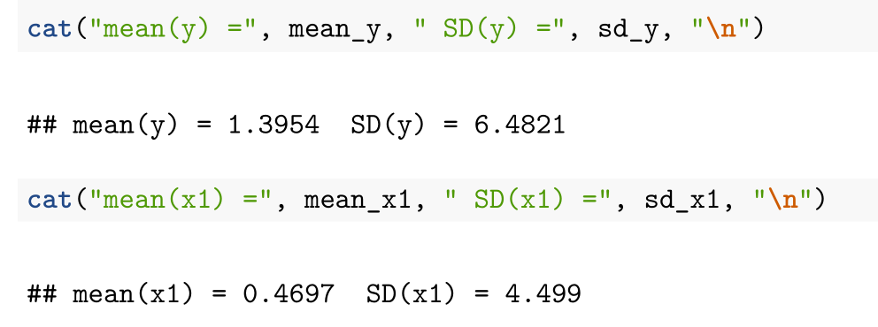
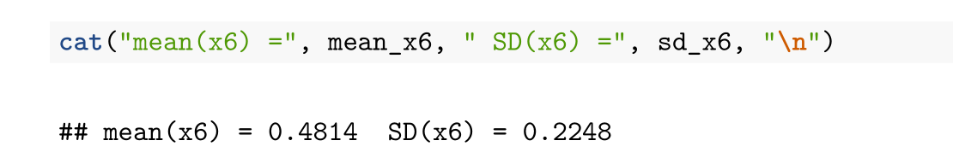
Problem 5
Background
Var | Mean | SD
y | 1.40 | 6.48
x1 | 0.47 | 4.50
x6 | 0.48 | 0.22
Using 492 monthly observations, we examine Portfolio.F (y) versus Market.x1 (x1) and rf rate.x6 (x6).
Returns are volatile
(x1: mean 0.47, SD 4.50;
x6: mean 0.48, SD 0.22;
y: mean 1.40, SD 6.48).
The purpose of this analysis is to assess whether Portfolio.F has a meaningful linear relationship with Market.x1 and rf tate.x6 using simple regression lines, identify the factor with stronger linear association, and report uncertainty ranges for the mean and individual responses at specified x values.

Slide 33
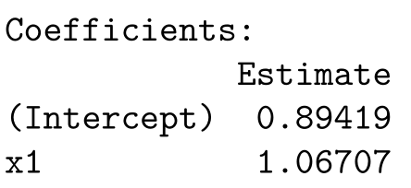
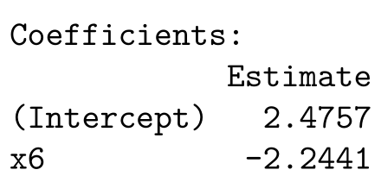
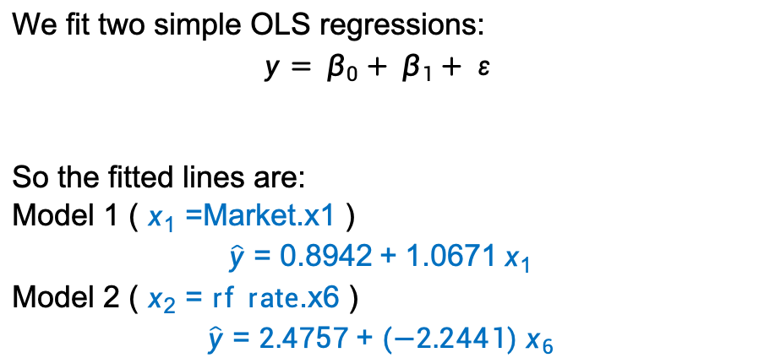
Problem 5 (a)
Method
R output evidence:
We fit two simple OLS regressions:
$$y= β_{0}+ β_{1}+ ε$$
So the fitted lines are:
Model 1 ( $x_{1}=$Market.x1 )
$$\hat{y}=0.8942+1.0671 x_{1}$$
Model 2 ( $x_{2}=rf rate$.x6 )
$$\hat{y}=2.4757+(−2.2441){ x}_{6}$$
Conclusion
Model 1: Positive slope (1.0671)
→ Market factor increases, Portfolio F tends to increase
Model 2: Negative slope (-2.2441)
→ Risk-free rate increases, Portfolio F tends to decrease

Slide 34



Problem 5 (b)
Model | Slope(b) | t-value | p-value | Conclusion
y~x1 | 1.0671 | 24.398 | <0.001 | Significant
y~x6 | -2.2441 | -1.728 | 0.0847 | Not Significant
Method
We examine whether each factor has a statistically meaningful linear effect on Portfolio.F using two separate simple OLS models. For each model, we estimate the slope 𝑏$1$and its standard error 𝑆𝐸(𝑏1), then test:
$$H_{0} :β=0 H_{1} :β≠0$$
$$t= \frac{b_{1}}{SE(b_{1})}, df=n−2=90, p=2P(\left|T_{df}\right|≥\left|t\right|)$$
We conclude significance if 𝑝<0.05.
Conclusion
1.P-value perspective:
- x₁: p < 0.001 → Strong evidence against H₀
- x₆: p = 0.0847 > 0.05 → Insufficient evidence against H₀
2. Visual perspective (see scatterplots):
- y vs x₁ shows clear positive linear trend
- y vs x₆ shows weak, scattered relationship

Slide 35

Problem 5 (c)
R output evidence:
Method
Comparison Criteria:
1. Correlation coefficient (r)
2. R-squared (R²)
Model | Correlation (r) | R-squared (R²)
y~x1 | 0.7406 | 0.5485
y~x6 | -0.0778 | 0.0061
Conclusion
Model 1 (x₁) is clearly superior:
- Much stronger correlation (0.7406 vs -0.0778)
- Much higher explanatory power (54.85% vs 0.61%)

Slide 36



Problem 5 (c)
Method
Because we use the same model as in Question 1 to compute the 95% prediction interval, the procedure and results are identical, so no further explanation is provided here.
Comparison with Model 2 (y~x6):
At x₆ = 0.25:
Mean CI: [1.0918, 2.7375], Individual PI: [-10.8225, 14.6518]
Conclusion of Queation 5:
The analysis shows that the market factor (x₁) is a significant predictor of Portfolio F returns (p < 0.001), with a strong positive correlation (r = 0.7406) and high explanatory power (R² = 0.5485); while the risk-free rate (x₆) has no significant effect (p = 0.085). Therefore, Model 1 (y ~ x₁) is the better choice. When the market factor is 1, the expected return is about 1.96%, though individual returns exhibit considerable uncertainty (interval: -6.61% to 10.54%).
The scatterplot clearly shows a strong positive linear relationship between Market.x1 and Portfolio.F.

Slide 37
Group Combined Effort
WU Chunyu

Slide 38



Objectives of Group Combined Effort
Construct simple regression models of y
with $x_{1}$ and${ x}_{n}$
Summarize the results from Questions 1–5
p-value-based significance testing( almost 𝑝<0.05)
Compare two evaluation criteria for all models: Correlation coefficient & R-square
Calculate correlation coefficient and $R_{}^{2}$
Choose the better model (Model 1)
recommend the best model for predicting Portfolio F returns
calculate the 95% prediction interval for specified x-values.

Slide 39
Model Evaluation Criteria
The larger the correlation
the stronger the linear relationship between x and y.
The larger the R-square
the better the model explains the variation in the response variable.

Slide 40

summary of the correlation and R-square for all models
Models | Question 1 | Question 2 | Question 3 | Question 4 | Question 5
Corr for M1 | $0.7406$ | $0.7406$ | 0.7406 | $0.7406$ | 0.7406
Corr for M2 | $0.7362$ | -0.2869 | -0.3333 | 0.7400 | -0.0778
R-square for M1 | 0.5485 | 0.5485 | 0.5485 | 0.5485 | 0.5485
R-square for M2 | 0.5420 | 0.0823 | 0.1111 | 0.5476 | 0.0061
Corr = correlation between x and y
R² = coefficient of determination
Model 1 uses x1; Model 2 uses the alternative factor in each question

Slide 41

Key Findings from Model Comparison
Model 1 (M1)
strong positive relationship between x1 and Portfolio F.
this correlation is high and consistent → changes in x1 reliably reflects changes in Portfolio F returns.
explains around half of the variation in y
Models | Question 1 | Question 2 | Question 3 | Question 4 | Question 5
Corr for M1 | $$0.7406$$ | $$0.7406$$ | 0.7406 | $$0.7406$$ | 0.7406
Corr for M2 | $$0.7362$$ | -0.2869 | -0.3333 | 0.7400 | -0.0778
R-square for M1 | 0.5485 | 0.5485 | 0.5485 | 0.5485 | 0.5485
R-square for M2 | 0.5420 | 0.0823 | 0.1111 | 0.5476 | 0.0061

Slide 42


Key Findings from Model Comparison
Model 2 (M2)
negative correlation,
increases in x do not correspond to increases in $y$—they may even move in opposite directions.
very low ,the model cannot explain the changes in $y$
Models | Question 1 | Question 2 | Question 3 | Question 4 | Question 5
Corr for M1 | $$0.7406$$ | $$0.7406$$ | 0.7406 | $$0.7406$$ | 0.7406
Corr for M2 | $$0.7362$$ | -0.2869 | -0.3333 | 0.7400 | -0.0778
R-square for M1 | 0.5485 | 0.5485 | 0.5485 | 0.5485 | 0.5485
R-square for M2 | 0.5420 | 0.0823 | 0.1111 | 0.5476 | 0.0061

Slide 43

final recommendation
model1!!!
The model with the higher correlation$0.7406$
•The model with the higher R-square 0.5485 → stronger explanatory power
Thus, we use Model 1 to calculate the Mean CI [1.0918, 2.7375] and Individual PI [-10.8225, 14.6518]
Market.x1 provides the strongest and most reliable explanation for the return of Portfolio F. From a business perspective, overall market return is useful for forecasting returns and supporting investment decisions.

Slide 44
Thank you

